Slide 1
Lesson 05: Loops
By Fabian Quicken

Slide 2

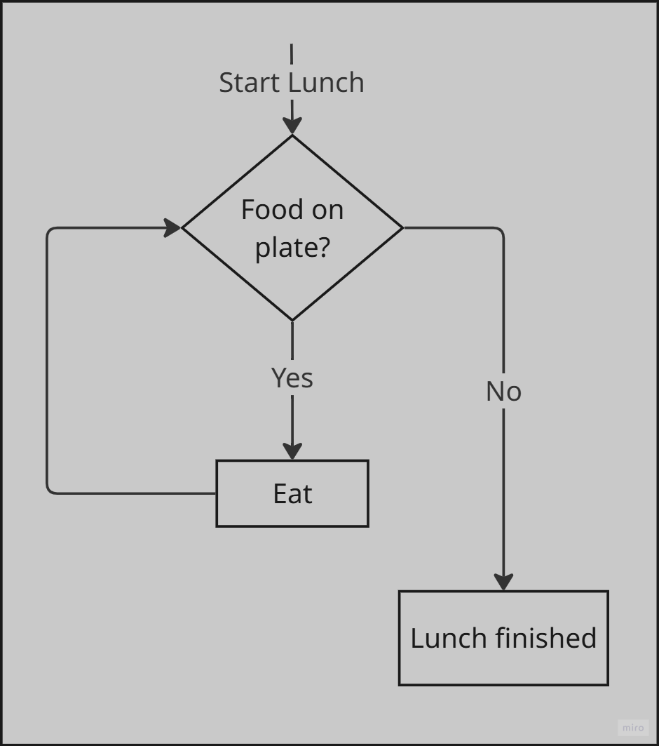
While loop logic:

Slide 3
While loops
while condition:
# do this
Runs a block of code until the condition evaluates „False“
Can run infinetly
Similar to „if“

Slide 4
Try this in you VSCode!
counter = 0
while counter <= 6:
print(counter)
counter += 1

Slide 5
Try this in you VSCode!
counter = 0
while counter <= 6:
print(counter)
counter += 1

Slide 6
Try this in you VSCode!
counter = 0
while counter <= 6:
print(counter)
counter += 1

Slide 7
Try this in you VSCode!
counter = 0
while counter <= 6:
print(counter)
counter += 1

Slide 8
Try this in you VSCode!
counter = 0
while counter <= 6:
print(counter)
counter += 1

Slide 9
Try this in you VSCode!
counter = 0
while counter <= 6:
print(counter)
counter += 1
while loops might end in infinite loops, if not careful! E.g. if the counter is not updated:
counter = 0
while counter <= 6:
print(counter)
press STRG + c to interrupt your code

Slide 10
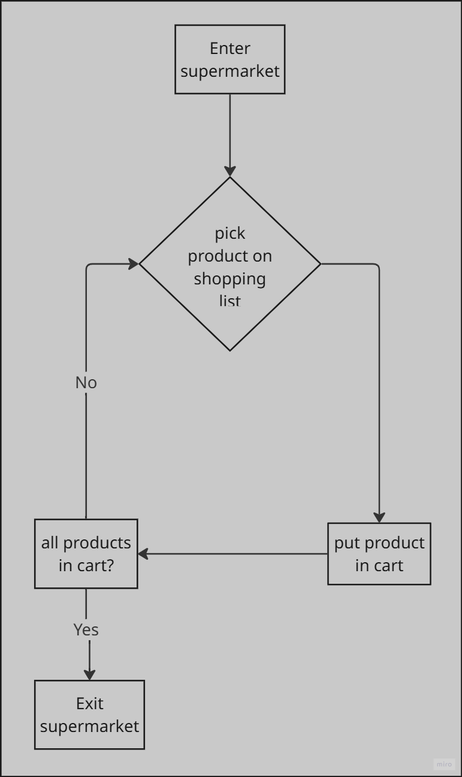
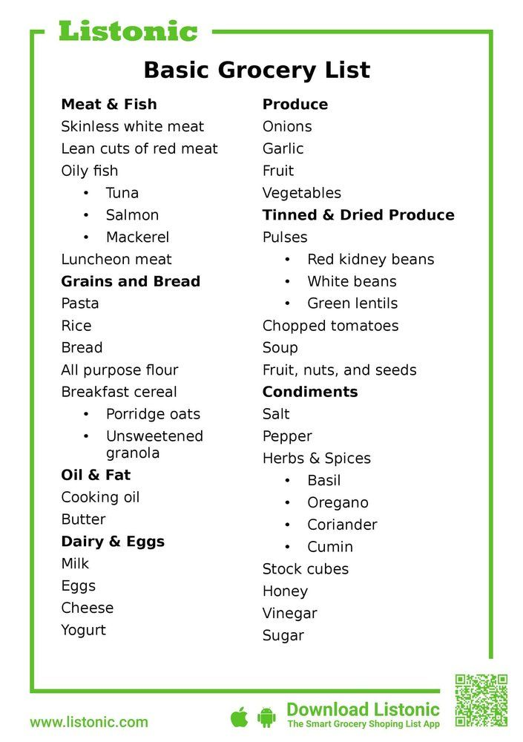

For loop logic
Notes:
Fills shopping cart 1 by 1

Slide 11
For loops - basics
for item in iterable:
# do this
Runs a block of code for each item in an iterable
→ e.g. list, tuple, string, dictionary, array
Exits, if worked on every item
Useful for efficient automatisation of repetetive tasks

Slide 12
For loops – range function
range(5)
Generates five numbers: 0, 1, 2, 3, 4 → range(n) counts from 0 to n-1
Try:
Used to do something n times
→ The current number is saved in a variable „i“
→ „i“ is just convention and can stand for iteration or index
for i in range(5):
print(i)

Slide 13
For loops – range function
Syntax of the range function:
Try:
range(start, stop, step)
for i in range(1,20,2):
print(i)

Slide 14
For loops – enumerate function
You have a number_list [2, 5, 3, 10, 1, 4, 7] and you want to know the position of elements in the list that are > 5, you can do this:
len(iterable) returns the lenght of an iterable, which allows iterating over each of the items in e.g. a list with a for loop, by giving the length of the list to the range function
for i in range(len(number_list)):
if number_list [i] > 5:
print(i)
[

Slide 15
For loops – enumerate function
You have a number_list [2, 5, 3, 10, 1, 4, 7] and you want to know the position of elements in the list that are > 5, you can ALSO do this:
Enumerate returns both the index and the element of an iterable
for i, item in enumerate(number_list):
if item > 5:
print(i)
[

Slide 16
Readibility – which is easier?
number_list = [2, 5, 3, 10, 1, 4, 7]
for i in range(len(number_list)):
if number_list [i] > 5:
print(i)
for i, number in enumerate(number_list):
if number > 5:
print(i)

Slide 17
Hands on part

